Slide 1


Case studies of coordinated THEMIS-SuperDARN observations of field line resonances
Elsayed R. Talaat
The Johns Hopkins University
Applied Physics Laboratory
Theodoros Sarris
University of Colorado, LASP

Slide 2
Outline
Characterization of ULF Waves by Themis and SuperDARN
Case study September 5, 2008
  Solar wind pressure pulse
Case study February 6-7, 2008
  Strong event across many local times
  No obvious excitation mechanism
  Eclipse

Slide 3
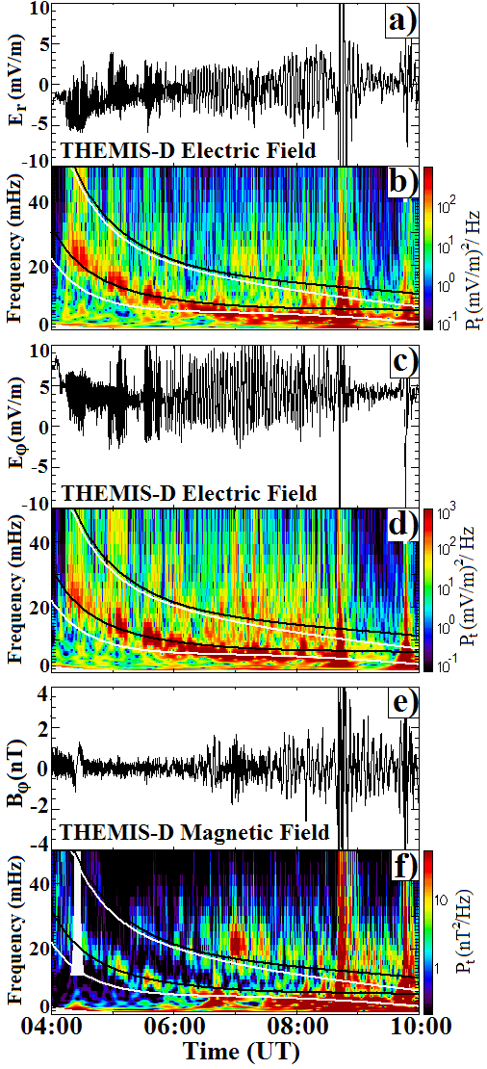
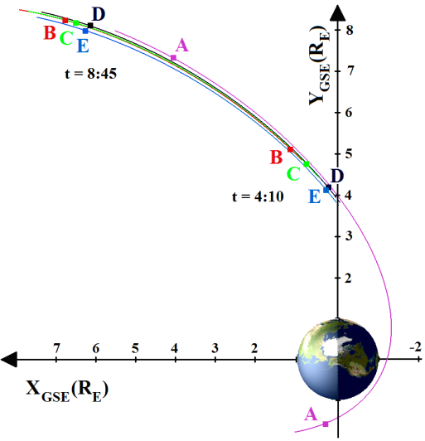
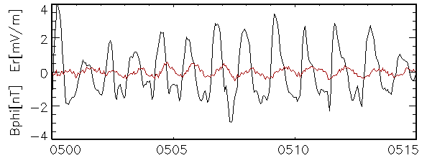
Themis Measurements
E- and B-field measurements during an outbound pass of the five THEMIS probes on 4 September 2007 from 04:00 to 10:00 UT. Er and Eφ in the XY plane in GSE are plotted with a 3 s resolution. The computed frequencies of the standing shear Alfvén waves are plotted over the DPS of the E- and B-field measurements in the color panels as white lines, representing the fundamental poloidal mode (lower line) and its first harmonic (upper line), and as black lines, representing the toroidal mode (lower line) and first harmonic (upper line). The E- and B-fields are orthogonal, indicating the appearance of standing wave field line resonances.

Slide 4
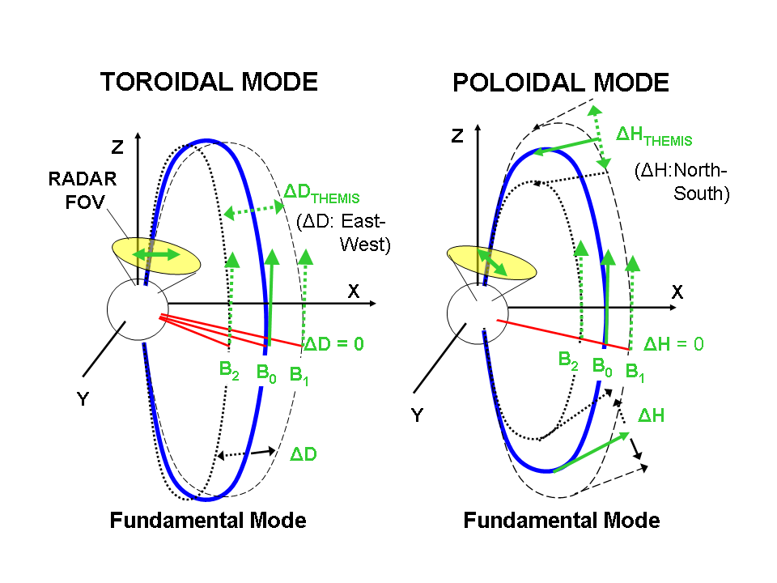
ULF wave field properties for different modes

Slide 6
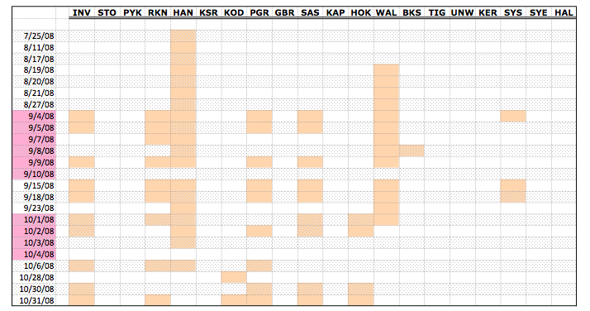

Slide 7
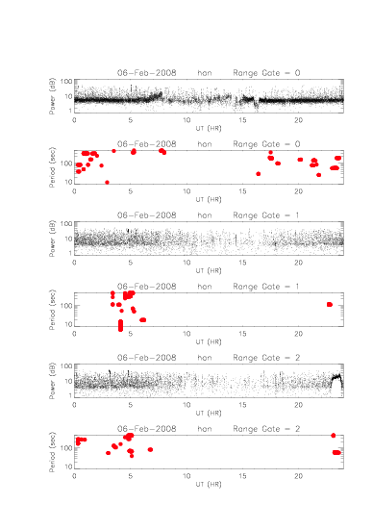
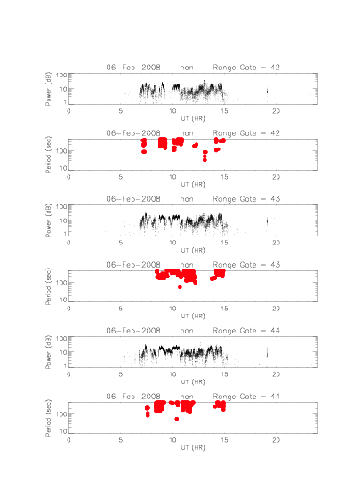
Wave detection dependent on scatter

Slide 8
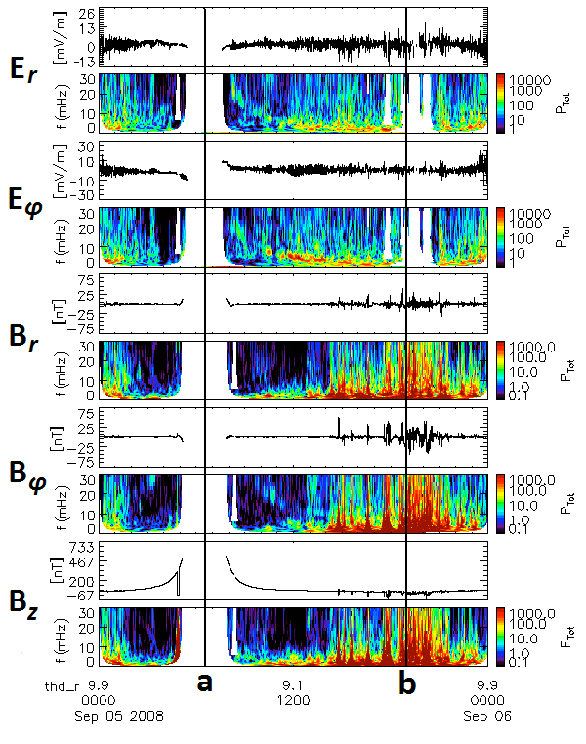
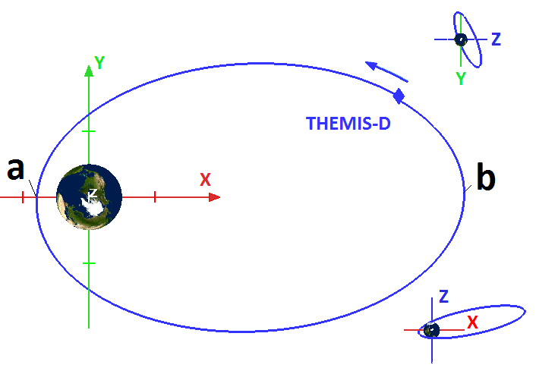
Field Line Resonance Observations
September 5, 2008
Measurements from
THEMIS‐D on 5 September
2008: radial component of the
electric field, Er; azimuthal
component of the electric field,
Eφ; and radial, azimuthal and
field‐aligned components of the
magnetic field, Br, Bφ and Bz, and their corresponding Dynamic
Power Spectra.

Slide 9
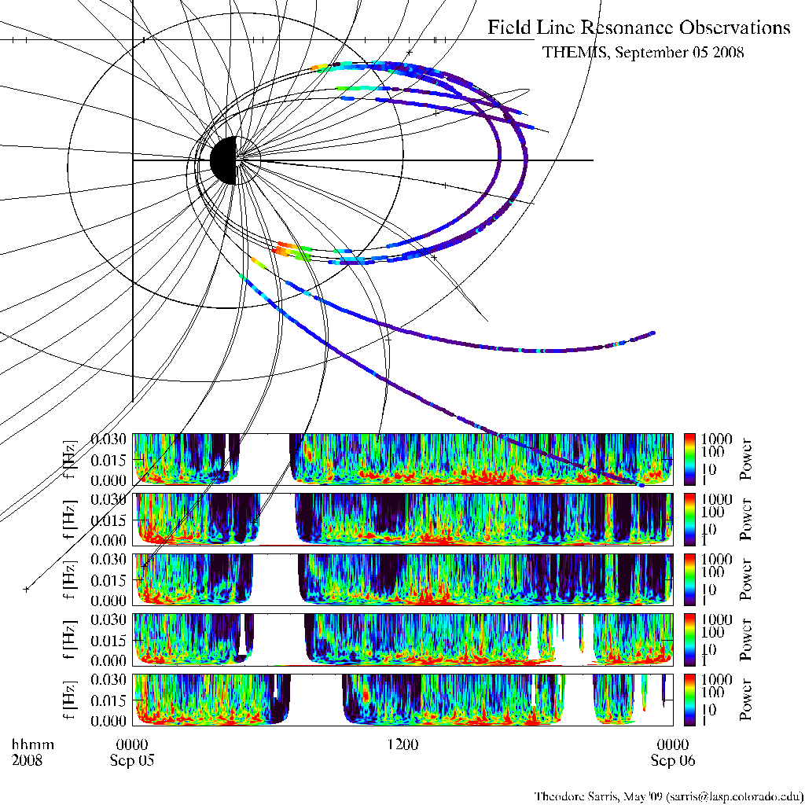
Field Line Resonance Observations
September 5, 2008

Slide 10
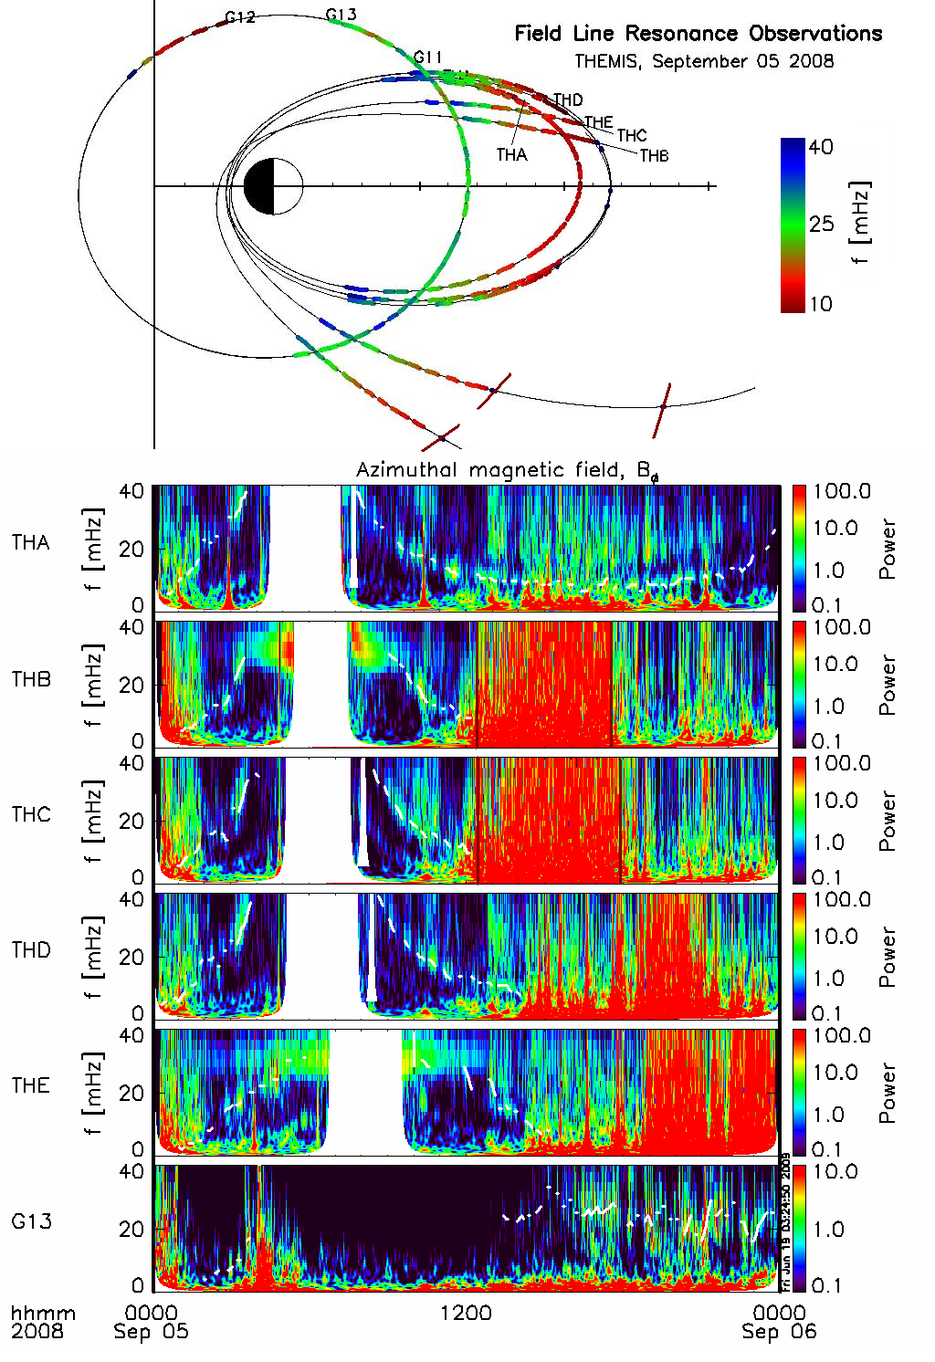
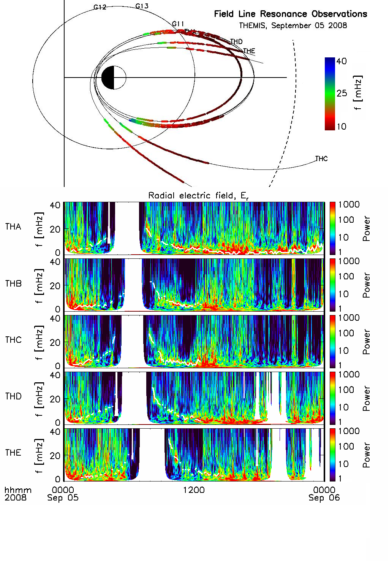

Slide 11
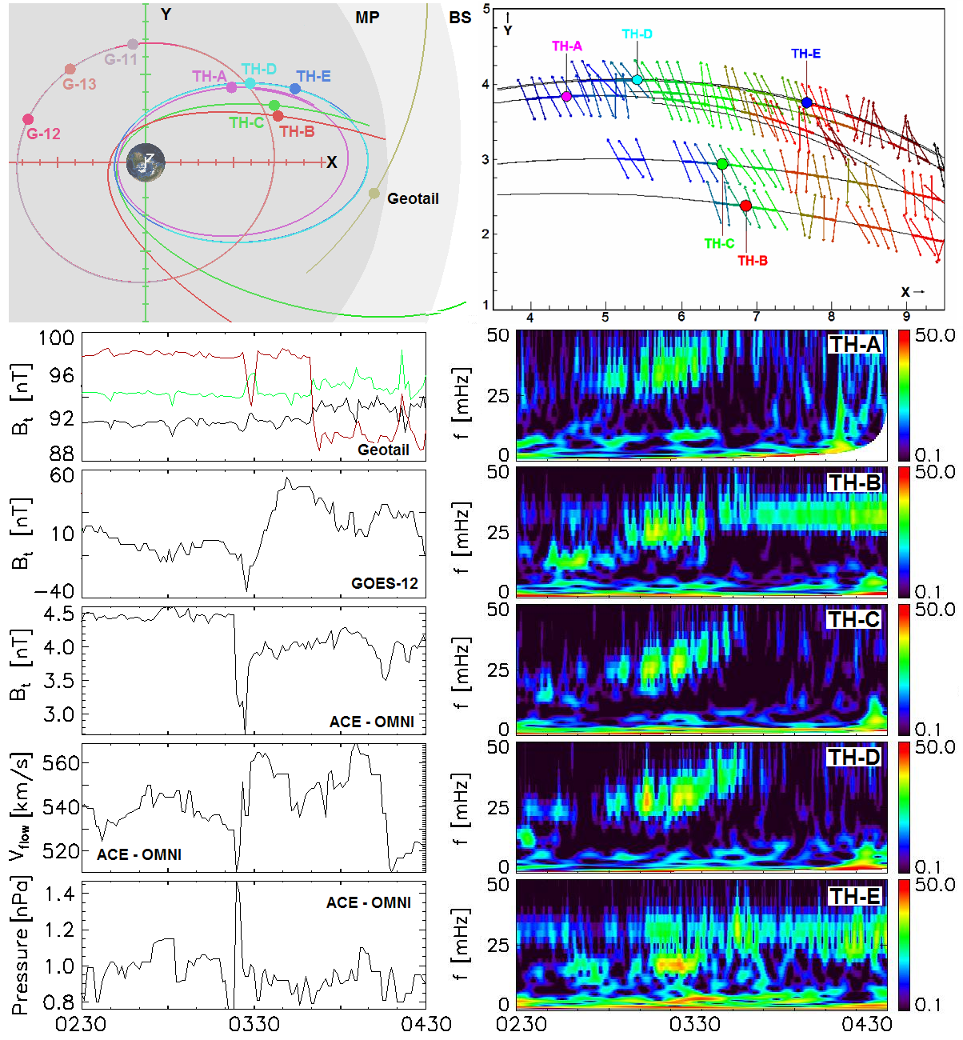

Slide 12
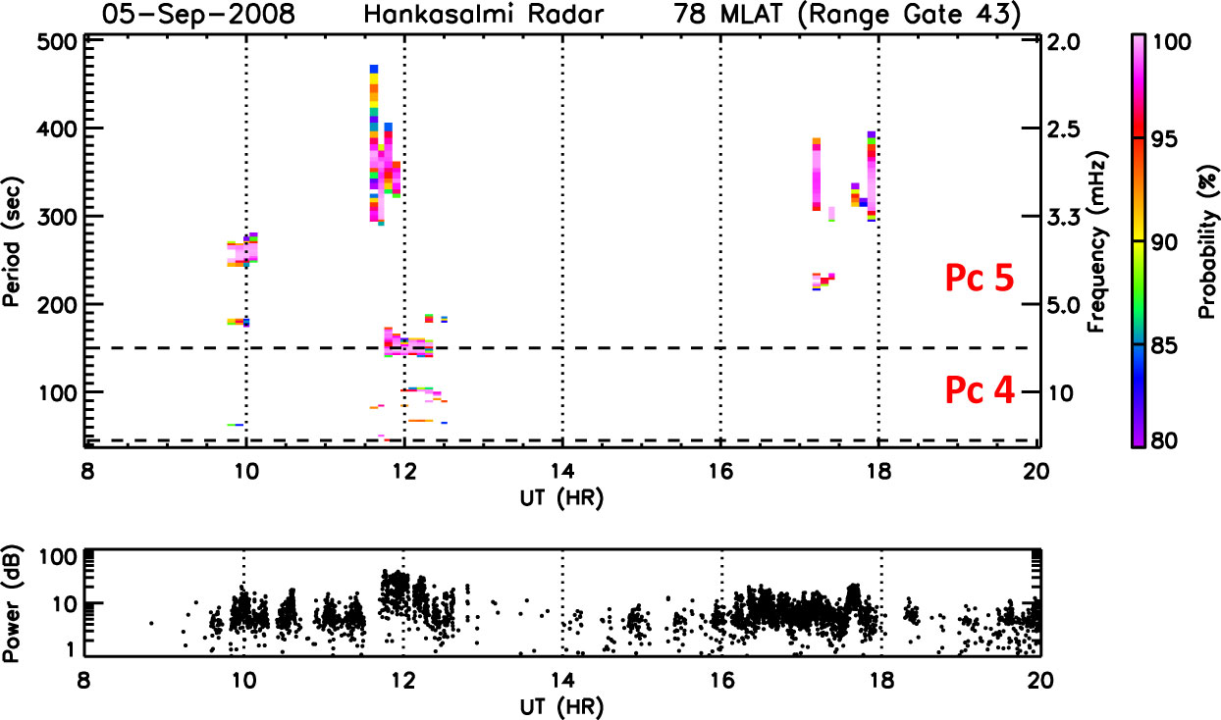
SuperDARN observations of FLR

Slide 13
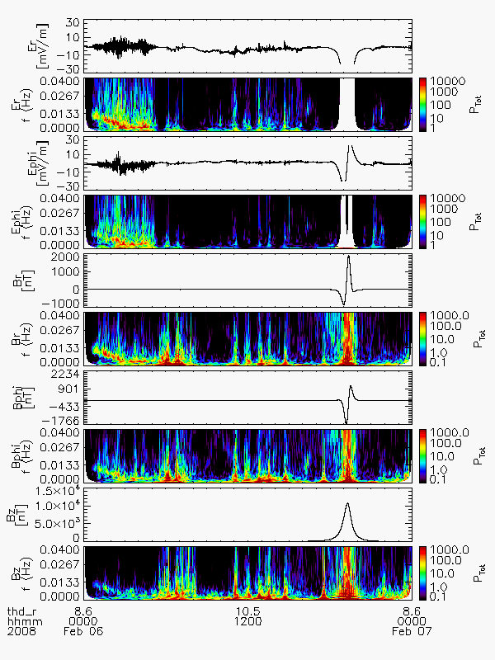
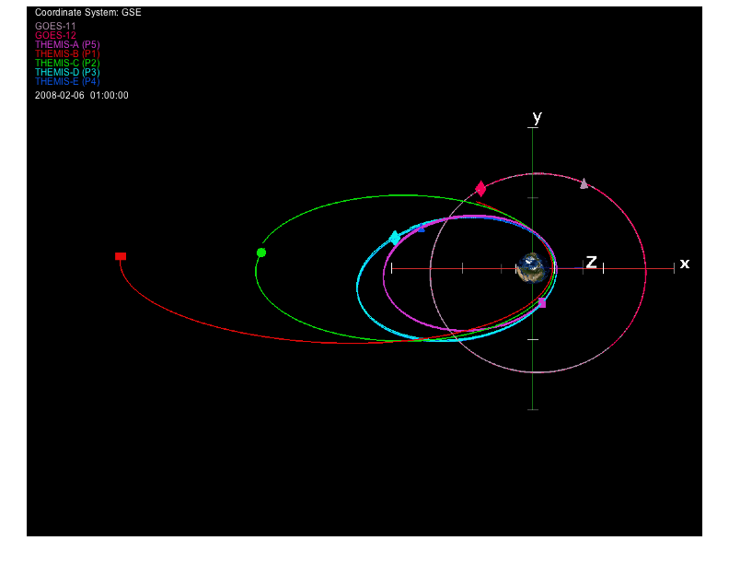
Field Line Resonance Observations
February 6, 2008
Measurements from
THEMIS‐D on 6 February
2008: radial component of the
electric field, Er; azimuthal
component of the electric field,
Eφ; and radial, azimuthal and
field‐aligned components of the
magnetic field, Br, Bφ and Bz, and their corresponding Dynamic
Power Spectra.

Slide 14
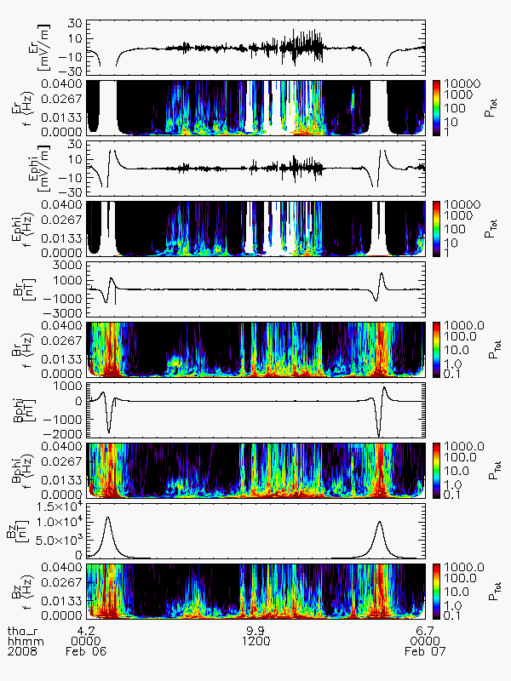
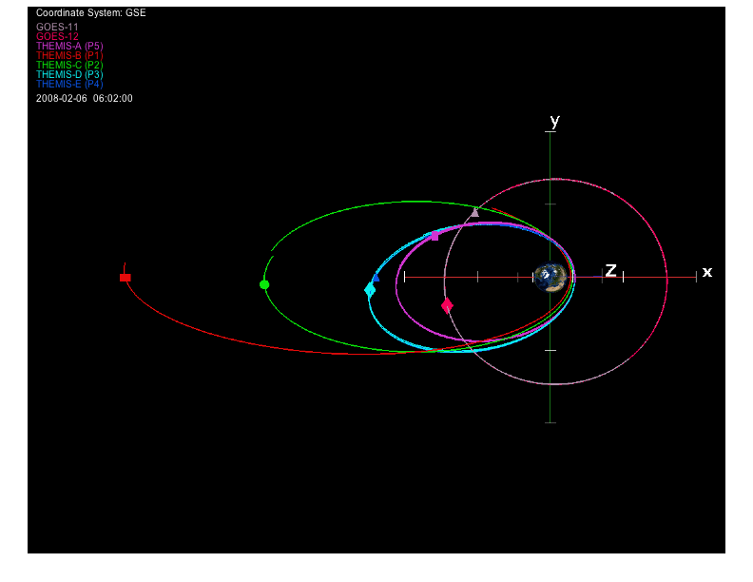
Field Line Resonance Observations
February 6, 2008
Measurements from
THEMIS‐D on 6 February
2008: radial component of the
electric field, Er; azimuthal
component of the electric field,
Eφ; and radial, azimuthal and
field‐aligned components of the
magnetic field, Br, Bφ and Bz, and their corresponding Dynamic
Power Spectra.

Slide 15
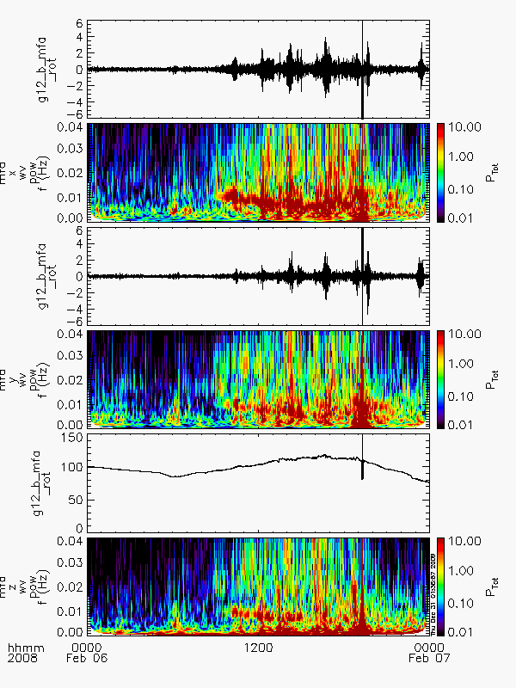
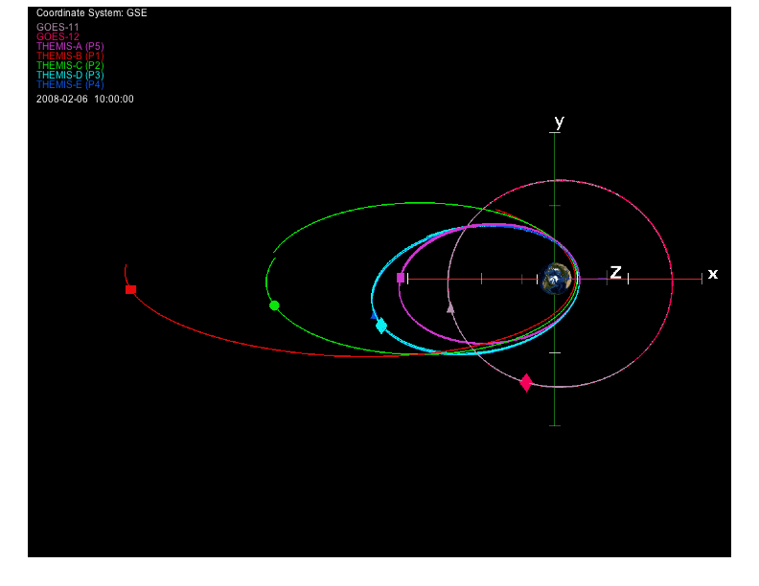
Field Line Resonance Observations
February 6, 2008
Measurements from
GEOS-12 on 6 February
2008: radial, azimuthal and
field‐aligned components of the
magnetic field, Br, Bφ and Bz, and their corresponding Dynamic
Power Spectra.

Slide 16
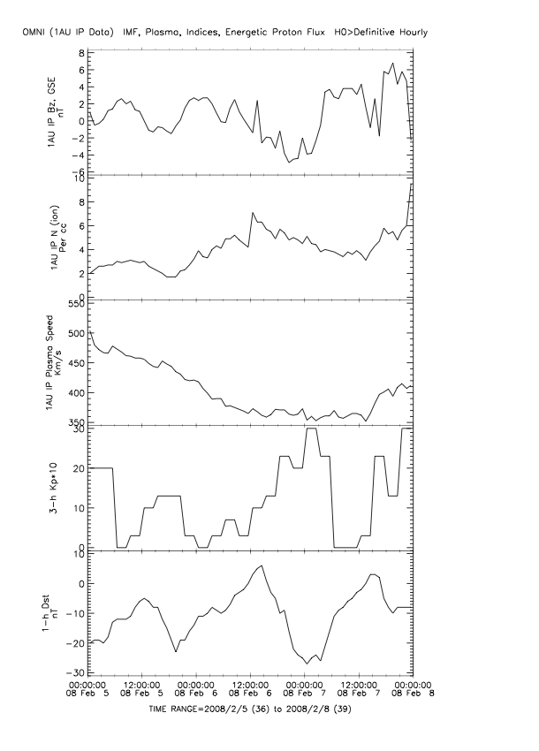

Slide 17
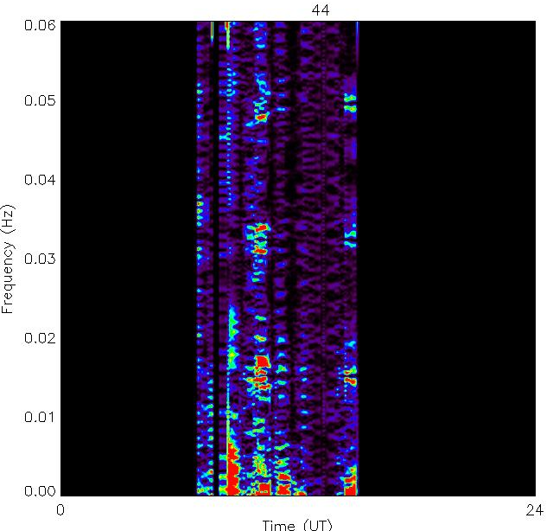
Hankasalmi - February 6, 2008

Slide 18
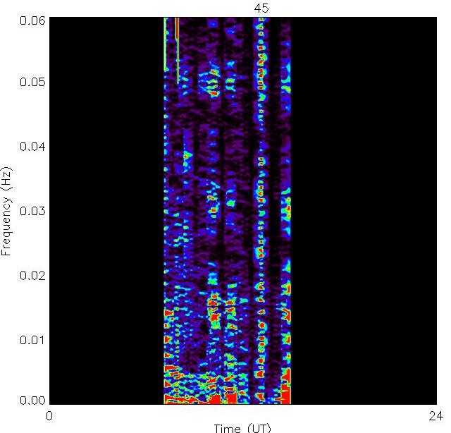
Hankasalmi - February 6, 2008

Slide 19
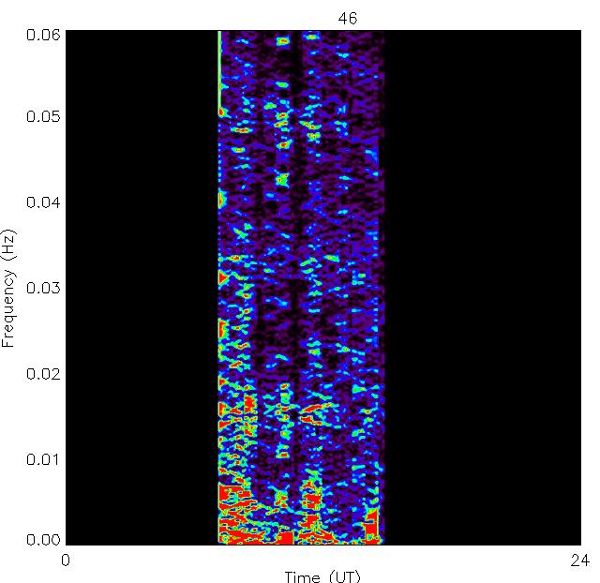
Hankasalmi - February 6, 2008

Slide 20
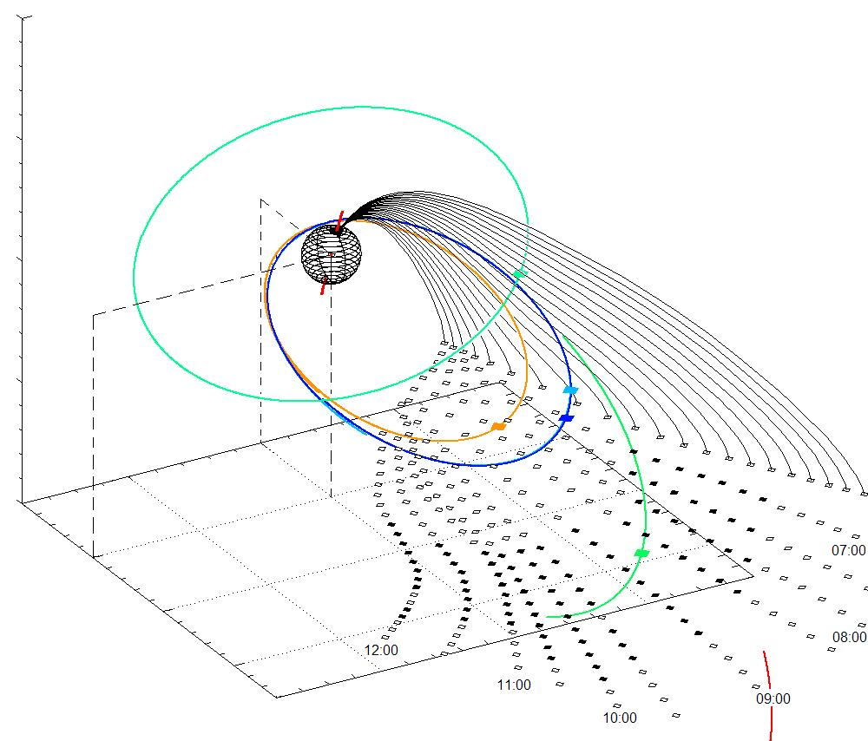
SuperDARN/Themis Coverage

Slide 21
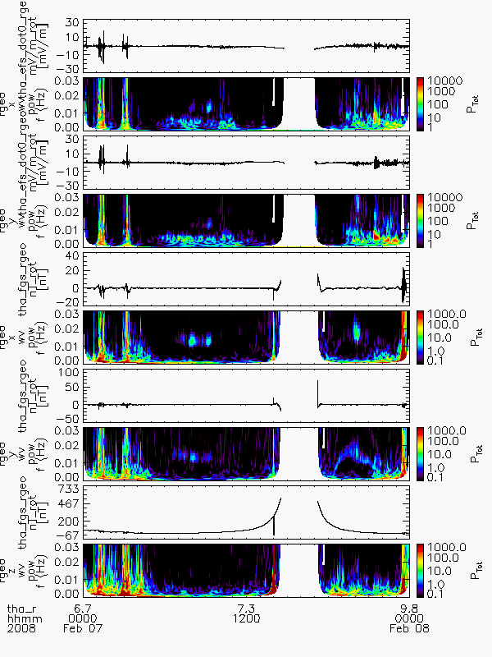
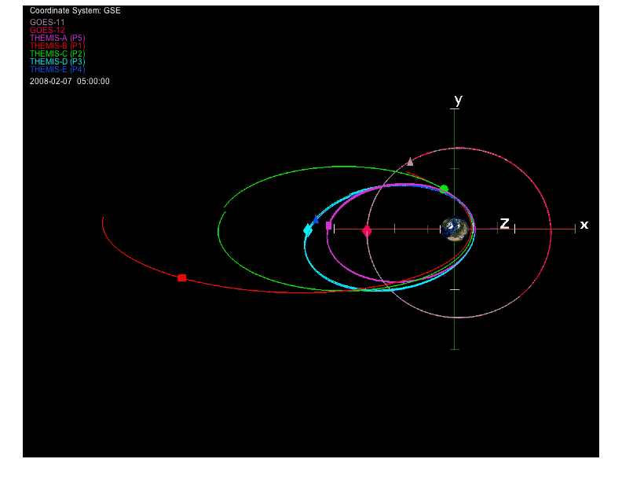
Field Line Resonance Observations
February 7, 2008
Measurements from
THEMIS‐A on 7 February
2008: radial component of the
electric field, Er; azimuthal
component of the electric field,
Eφ; and radial, azimuthal and
field‐aligned components of the
magnetic field, Br, Bφ and Bz, and their corresponding Dynamic
Power Spectra.

Slide 22
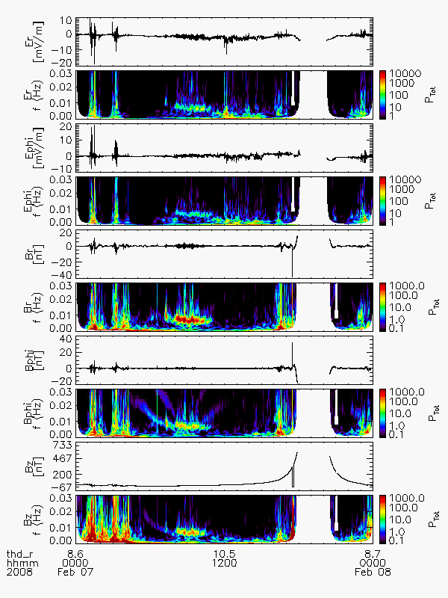
Field Line Resonance Observations
February 7, 2008
Measurements from
THEMIS‐D on 7 February
2008: radial component of the
electric field, Er; azimuthal
component of the electric field,
Eφ; and radial, azimuthal and
field‐aligned components of the
magnetic field, Br, Bφ and Bz, and their corresponding Dynamic
Power Spectra.

Slide 23
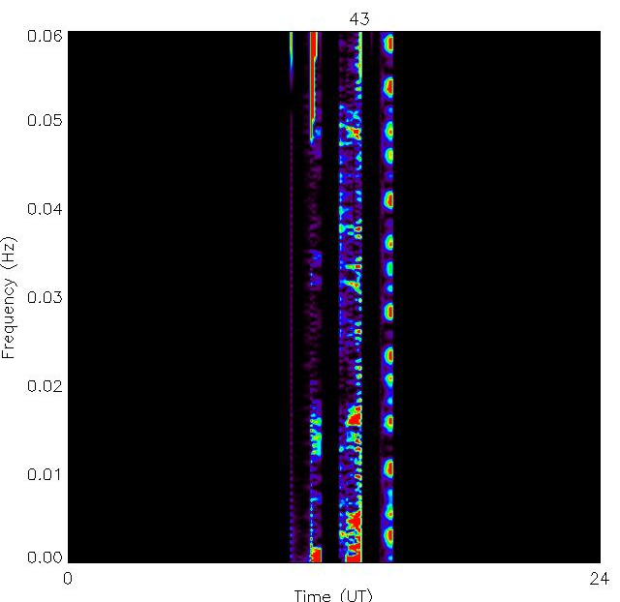
Hankasalmi – February 7, 2008

Slide 24
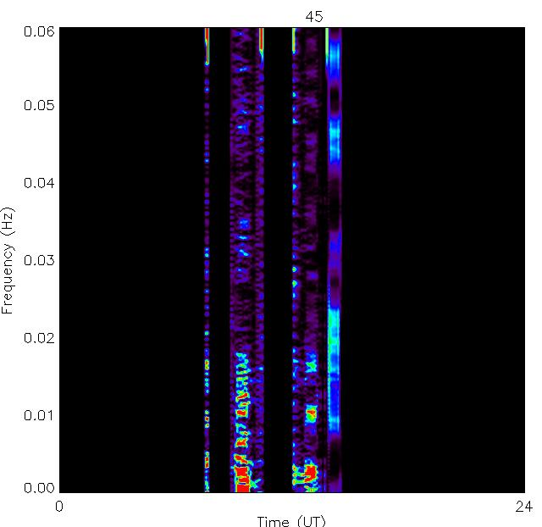
Hankasalmi – February 7, 2008

Slide 25
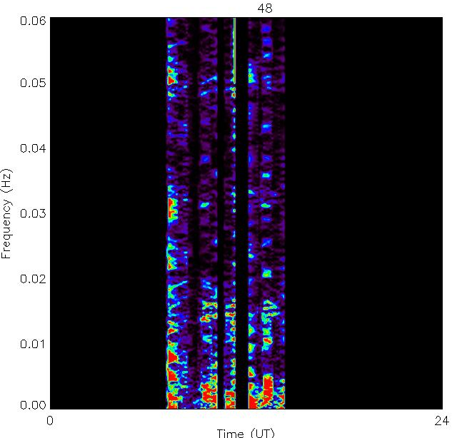
Hankasalmi – February 7, 2008

Slide 26
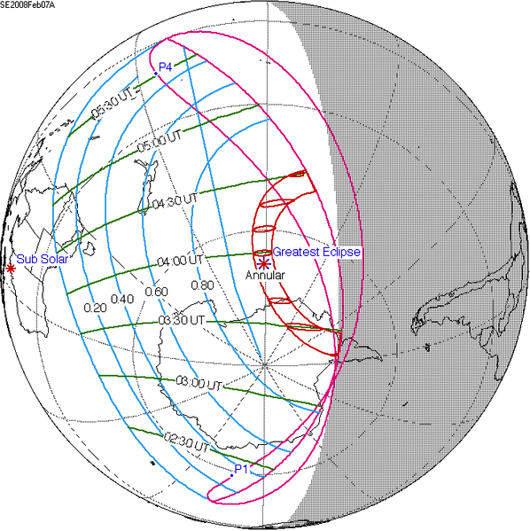
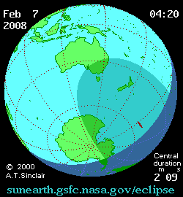
Interesting Aside
The FLR mechanism can be disturbed by a change in particle density/distribution along the actual field line.

Slide 27
Summary
Characterization of ULF Waves by Themis and SuperDARN
Case study September 5, 2008
  Solar wind pressure pulse intensification of toroidal FLR
Case study February 6-7, 2008
  Strong event across many local times
  No obvious excitation mechanism of poloidal FLR
  Eclipse

Slide 28
ULF waves observed from ground
 | Continuous pulsations |  |  |  |  | Irregular (Impulsive) pulsations
 | Pc 1 | Pc 2 | Pc 3 | Pc 4 | Pc 5 | Pi 1 | Pi 2
T (sec) | 0.2-5 | 5-10 | 10-45 | 45-150 | 150-600 | 1-40 | 40-150
f | 0.2-5 Hz | 0.1-0.2 Hz | 22-100 mHz | 7-22 mHz | 2-7 mHz | 0.025-1 Hz | 2-25 mHz

Slide 29
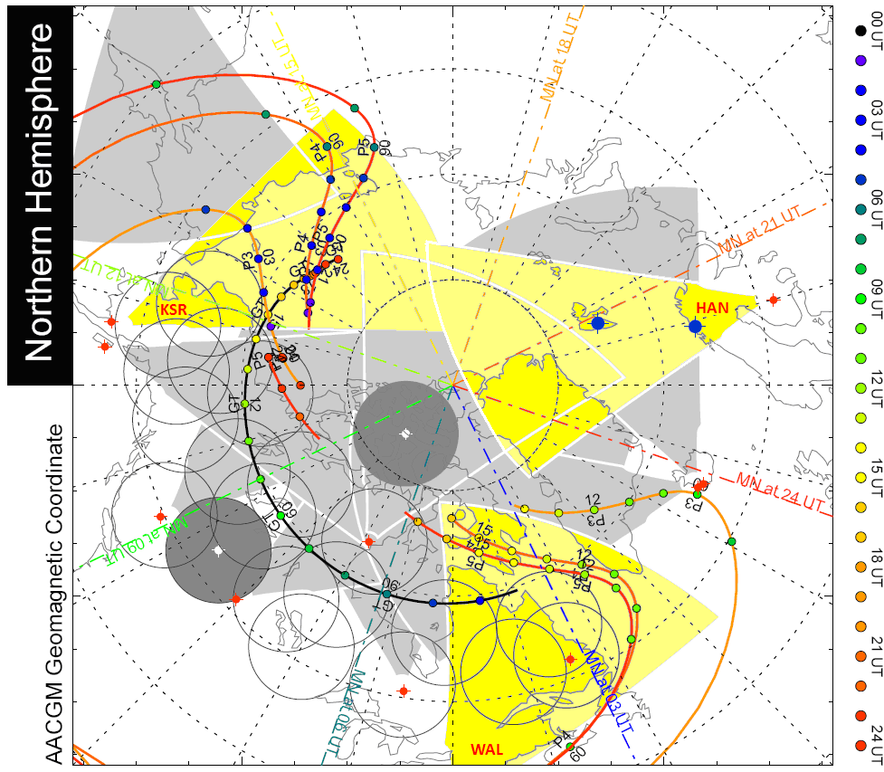
Themis-SuperDARN Coincidences

Slide 30
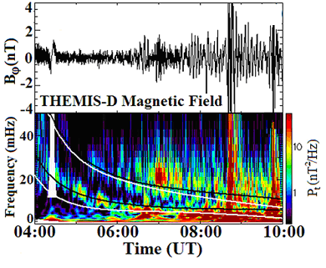
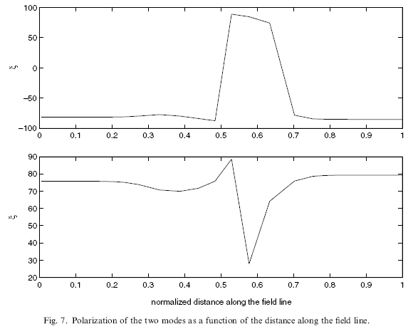
the field line.
Computed frequencies of the standing shear Alfvén waves are plotted over the electric and magnetic field.
Polarization of the two modes as a function of distance along the field line.

